Slide 1
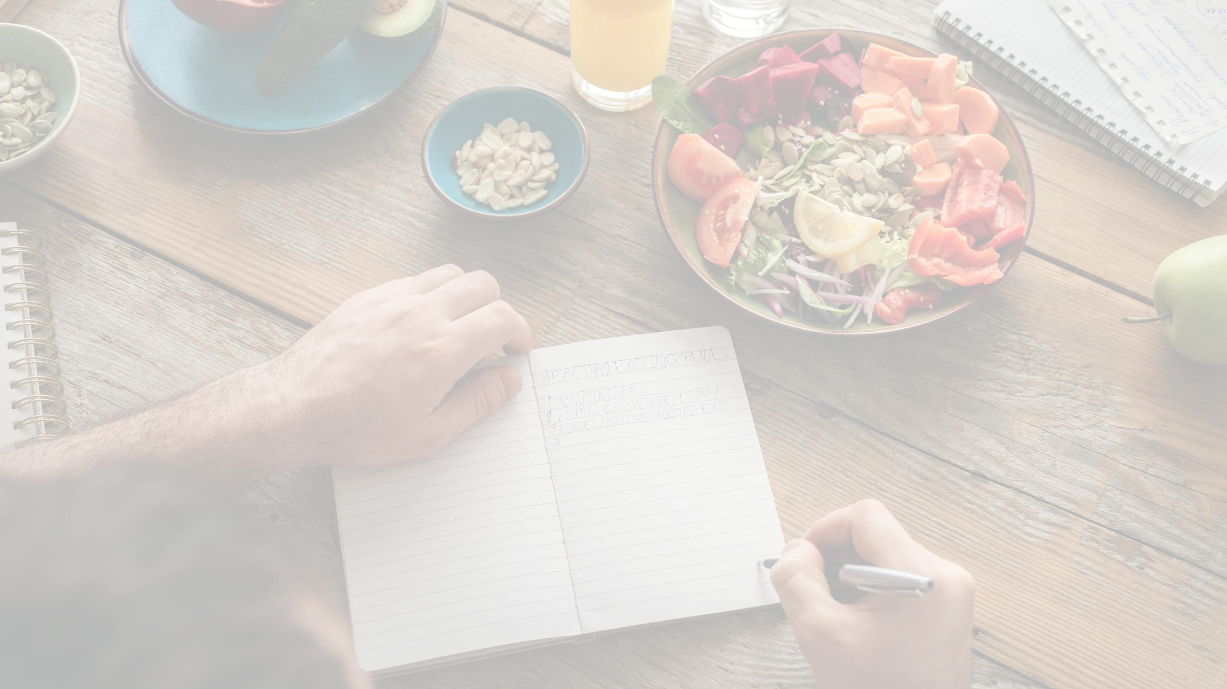

THE VEDIC LIFESTYLE COURSE
AYURVEDA FOR DAILY LIFE
Session 01

Slide 2
The doctor of the future will give no medicine but will interest his patients in the care of the human frame, in the diet, and in the cause and prevention of disease.
Thomas Edison

Slide 3
4 SESSIONS
AYURVEDA FOR DAILY LIFE
01
18 June, Saturday
YOGA FOR DAILY LIFE
02
19 June, Sunday
ASTROLOGY FOR DAILY LIFE
03
25 June, Saturday
BHAKTI FOR DAILY LIFE
04
26 June, Sunday

Slide 4

AYURVEDA FOR DAILY LIFE
SESSION 01
Simple Practices for Daily Life

Slide 5
IN TODAY'S SESSION
01
HOW TO OPTIMISE YOUR DAILY ROUTINE
- FOLLOWING AN AYURVEDA CLOCK
02
THE TOP 5 SELF-CARE MORNING PRACTICES
HOW TO DO A SIMPLE SELF MASSAGE - ABHYANGA
03
04
NATURAL REMEDIES FOR COMMON IMBALANCES

Slide 6
WHAT IS HEALTH?

Slide 7
According to Sushruta, the definition of a healthy person is "one who has balanced doshas, balanced agni, properly formed dhatus, proper elimination of waste products, all bodily functions are proper, and whose soul, mind, and five senses are in bliss."

Slide 8
Follow an Ayurvedic Clock
KAPHA - Heavy, Stable, Slow, Dense
6-10 AM - the best time to do exercise to dispel the heaviness from you body.
KAPHA
6-10
6-10 PM - eat a light dinner

Slide 9
Follow an Ayurvedic Clock
PITA - Hot & Energetic
PITA
10-2
Midday - eat your biggest meal
Night - internal rebuilding and cleansing
KAPHA
6-10

Slide 10
Follow an Ayurvedic Clock
VATA - Light, Changing & Moving
PITA
10-2
Waking up during the brahma muhurta is conducive to producing a balanced, serene mind.
KAPHA
6-10
VATA
2-6
2-6 PM is a good time to study and work, vata stimulates mental activity.

Slide 11
HOW TO OPTIMISE YOUR DAILY ROUTINE
- FOLLOWING AN AYURVEDA CLOCK
01
02
THE TOP 5 SELF-CARE MORNING PRACTICES
HOW TO DO A SIMPLE SELF MASSAGE - ABHYANGA
03
NATURAL REMEDIES FOR COMMON IMBALANCES
04

Slide 12

THE TOP 5 SELF-CARE MORNING PRACTICES
RISE BEFORE SUNRISE

Slide 13
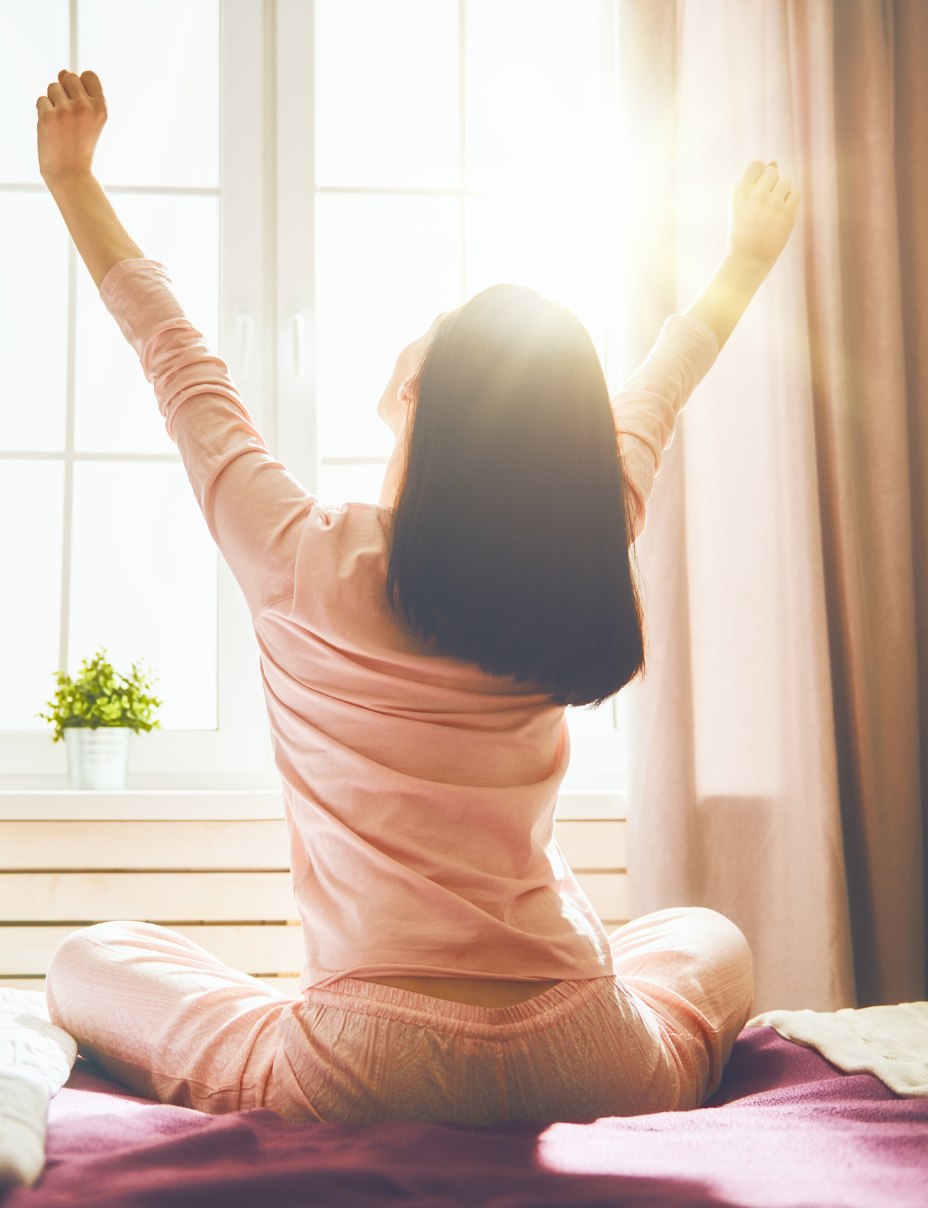
RISE BEFORE SUNRISE
‘Brahma Muhurta’ - 1 ½ hours (90 mins) before sunrise and lasts for 48 minutes.
"Waking up during Brahma Muhurta increases one’s lifespan and helps avoid diseases."
Ashtanga Hridaya

Slide 14
IN BRAHMA MUHURTA
Prana (life force) & Sattwa (purity) are enlivened
The Doshas are in their equilibrium state
Our connection to Nature is more complete
Energy and Creativity increase
Mind and body are more clear & alert
Body is more flexible and able to change
Toxins & dullness clear best
Mind expands & absorbs more
Knowledge/perception is best
Agni is enlivened & strengthened more then

Slide 15
THINGS TO DO DURING BRAHMA MUHURTA
Meditate and pray
Read Scriptures
Do Abhyanga
Yoga
Journal
Walk
Listen to chanting or prayer
Affirmations
Make a plan for the day

Slide 16
DURING BRAHMA MUHURTA AVOID
Eating
Straining mentally or physically

Slide 17
Brahmi Muhurta Uthishta Jeerna Ajeerna Nirupayan
This shloka advises us to get up in the Brahma Muhurta if we have fully digested our food. If not we need to sleep more, so the night-time digestive cycle can finish properly. Otherwise, indigestion will linger and the next day's food will not digest well.

Slide 18
Eat early & light in the night and go to bed early. With this, the earlier food will be digested & you can wake up early. And when the digestive system is clear, there is no chance of getting Ama that leads to disease.

Slide 19
THE TOP 5 SELF-CARE MORNING PRACTICES
RISE BEFORE SUNRISE
OFFER A PRAYER OF GRATITUDE

Slide 20

OFFER A PRAYER OF GRATITUDE
"Thank you God for this beautiful day before me."
Positive affirmation such as: "I am happy, I am healthy, and I am healing." "I am grateful to be alive, I am blessed by the best." A simple affirmation statement rewires how you feel about that day.

Slide 21

THE TOP 5 SELF-CARE MORNING PRACTICES
RISE BEFORE SUNRISE
OFFER A PRAYER OF GRATITUDE
HAVE A STEWED APPLE

Slide 22
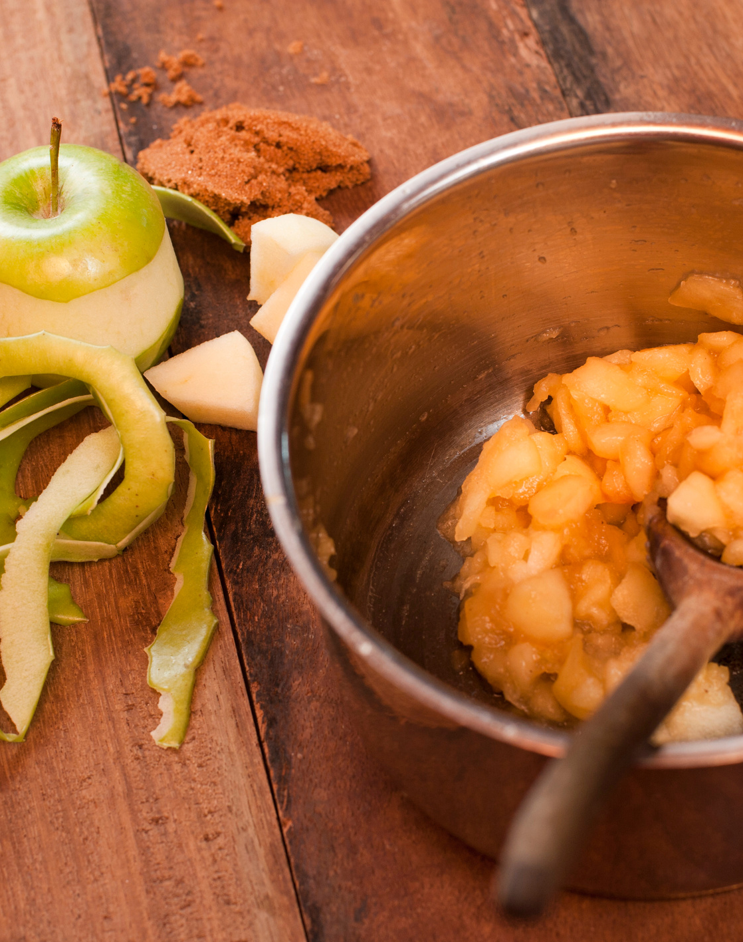
HAVE A STEWED APPLE
Apples contain pectin, which functions as a prebiotic in the gut. Cooking the apple makes it easier to digest, and cloves ignite the weak digestive fire in the morning without creating too much pitta or heat.

Slide 23

Room temperature, warm, or sipping hot water is fine in the morning (never cold). Hot water will stimulate bowel movements.
Do not take lemon water as the first taste in the morning. It has a sour taste that is too “scraping” for the body at that time of day (though it’s fine to have lemon water later).
NEVER take lemon water or any warm/hot drink with honey, as honey becomes toxic when heated even a little.
Sipping plain hot water frequently for the remainder of the day is very important (frequency matters, not quantity) Helps to open all the channels, and when the channels are more open, the flow of toxins will be free.

Slide 24

THE TOP 5 SELF-CARE MORNING PRACTICES
RISE BEFORE SUNRISE
OFFER A PRAYER OF GRATITUDE
HAVE A STEWED APPLE
APPLY OIL DROPS IN THE NOSE

Slide 25
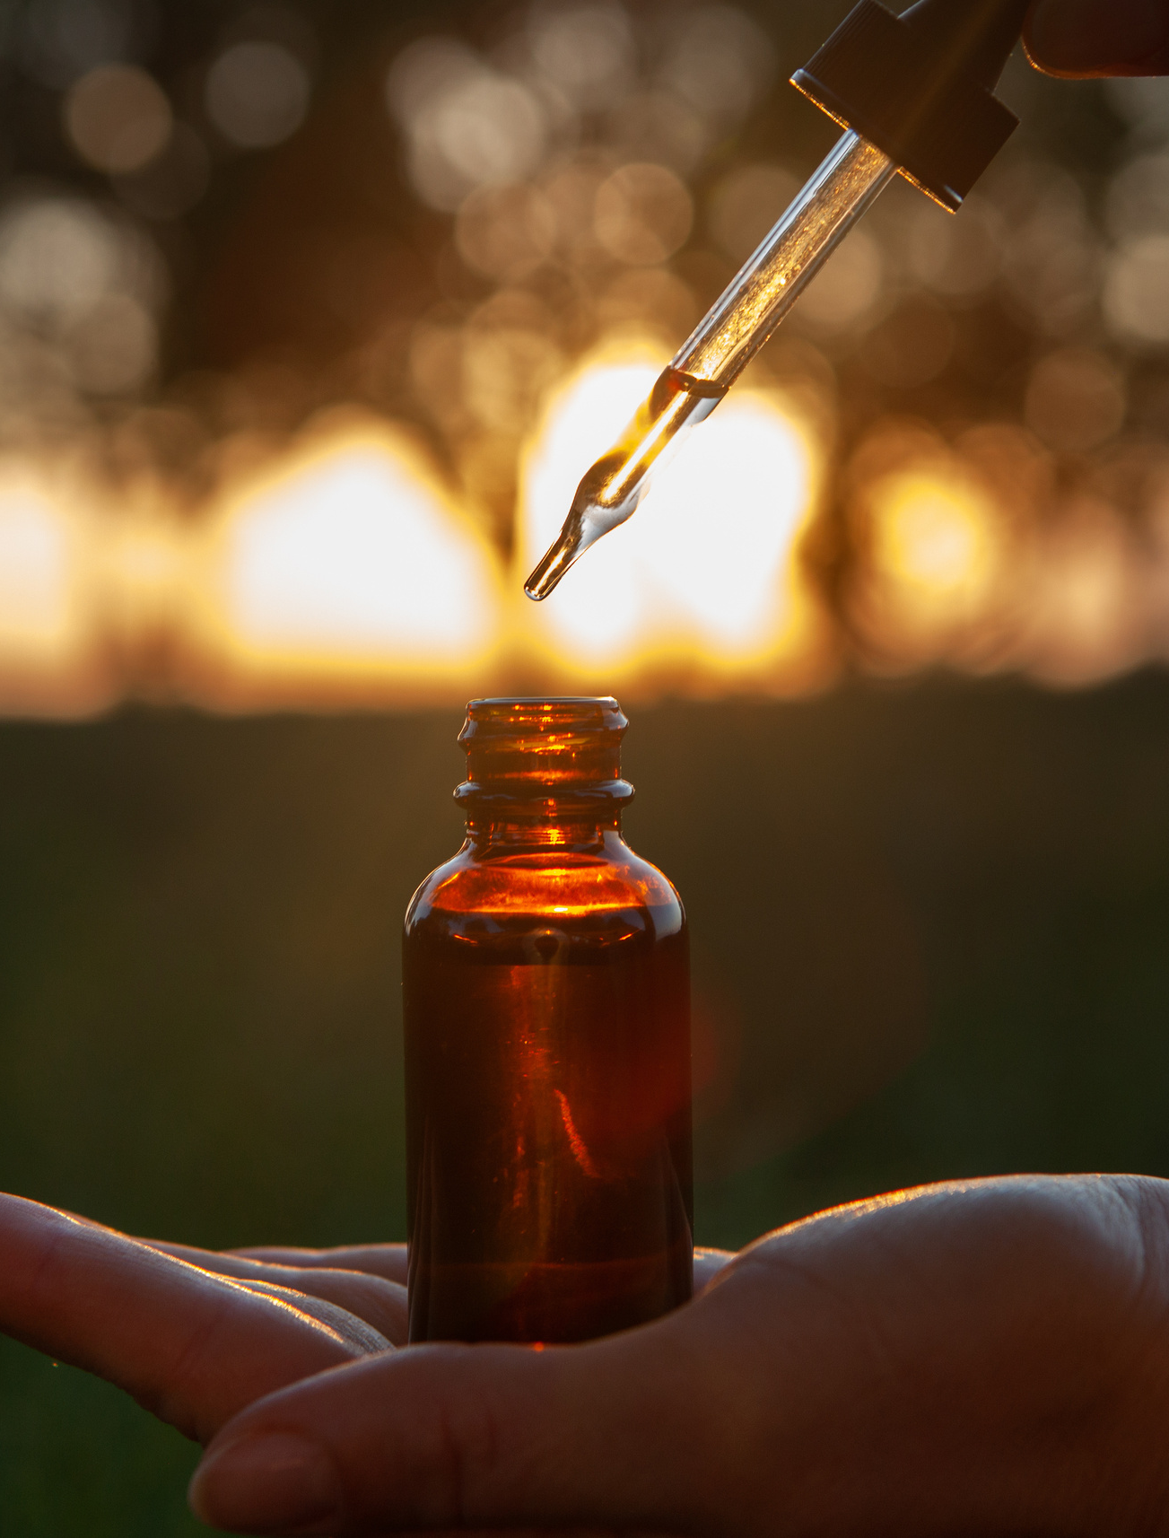
APPLY OIL DROPS IN THE NOSE
Nasya improves our immunity and prevents hair fall, graying of the hair, chronic headache, eye diseases, allergies, can be useful in infertility issues.
Nasya Oil is also traditionally said to improve quality of voice, strengthen vision and promote mental clarity.

Slide 26
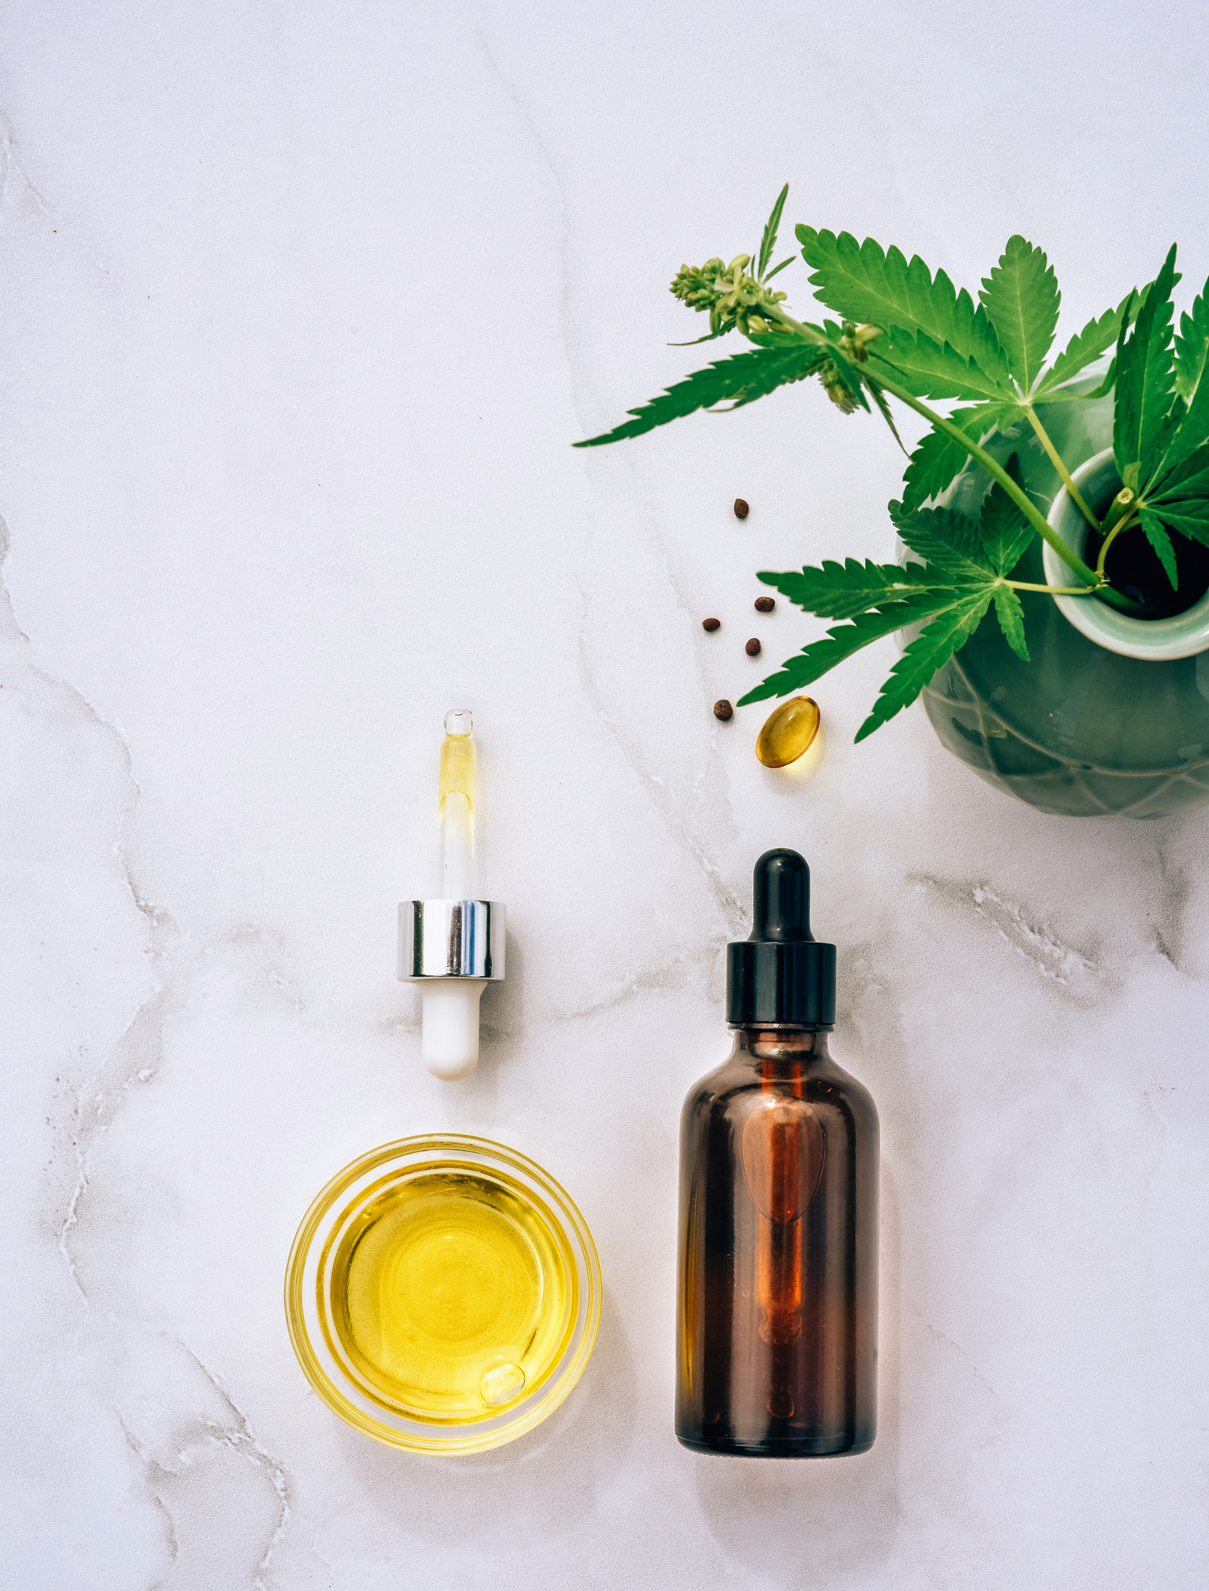
APPLY OIL DROPS IN THE NOSE
Nasya clears out all the channels in the head & skull and sends the toxins away through the nose.
Activates the brain and opens all the channels in the face & skull. Then the proper lubrication will happen for the whole skull, sensory organs & thyroid too.

Slide 27

THE TOP 5 SELF-CARE MORNING PRACTICES
RISE BEFORE SUNRISE
OFFER A PRAYER OF GRATITUDE
HAVE A STEWED APPLE
APPLY OIL DROPS IN THE NOSE
SELF-MASSAGE - ABHYANGA

Slide 28

ABHYANGA
After getting up in the Brahma Muhurta, Abhyanga is one of the main important things we can do for our health. It is considered as a treatment because it purifies & strengthens; and as a Rasayana because it rejuvenates.

Slide 29
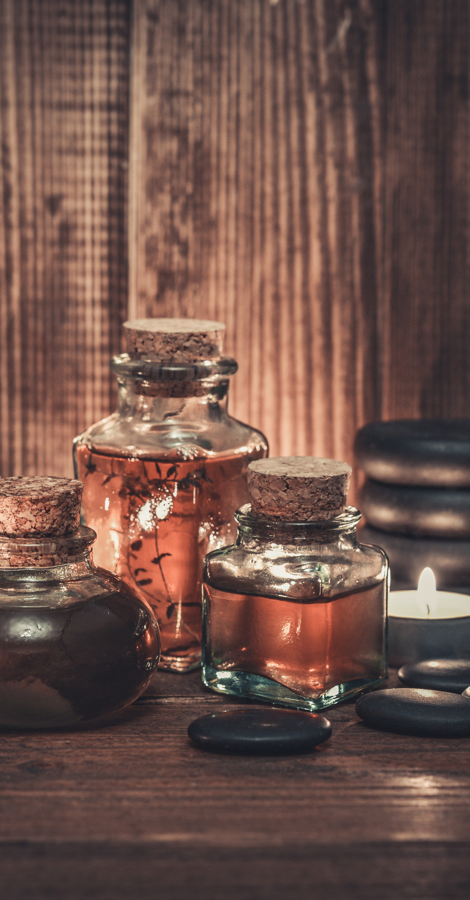
Benefits of Abhyanga
Nourishes the entire body—decreases the effects of aging
Imparts a firmness to the limbs and muscles
Lubricates the joints
Increases circulation
Stimulates the internal organs of the body
Assists in elimination of impurities from the body
Moves the lymph, aiding in detoxification
Calms the nerves
Benefits sleep—better, deeper sleep
Makes hair (scalp) grow luxuriantly, thick, soft and glossy
Softens and smoothens skin; reduces wrinkles
Pacifies Vata and Pitta and stimulates Kapha

Slide 30
HOW TO OPTIMISE YOUR DAILY ROUTINE
- FOLLOWING AN AYURVEDA CLOCK
01
02
THE TOP 5 SELF-CARE MORNING PRACTICES
HOW TO DO A SIMPLE SELF MASSAGE - ABHYANGA
03
NATURAL REMEDIES FOR COMMON IMBALANCES
04

Slide 31
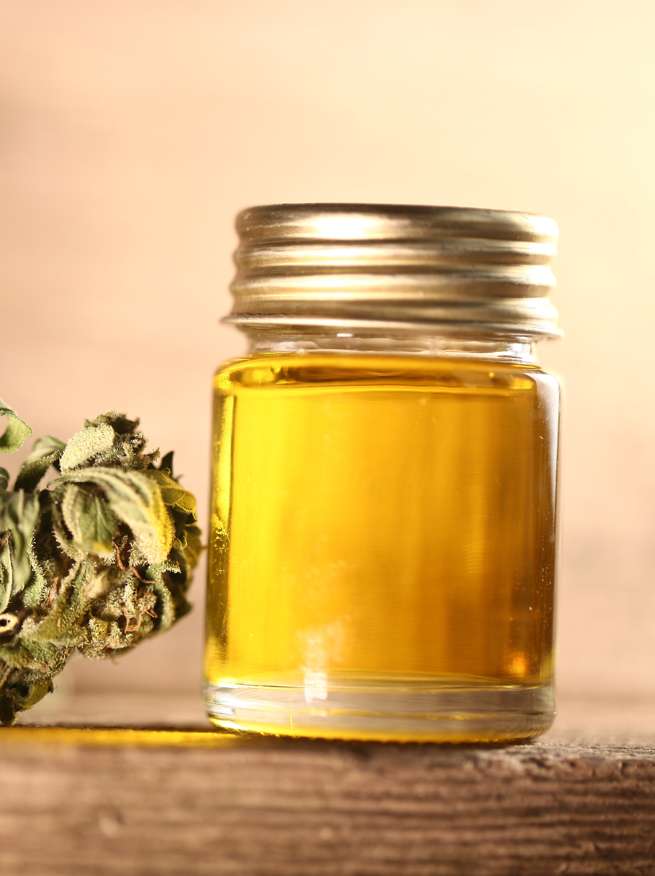
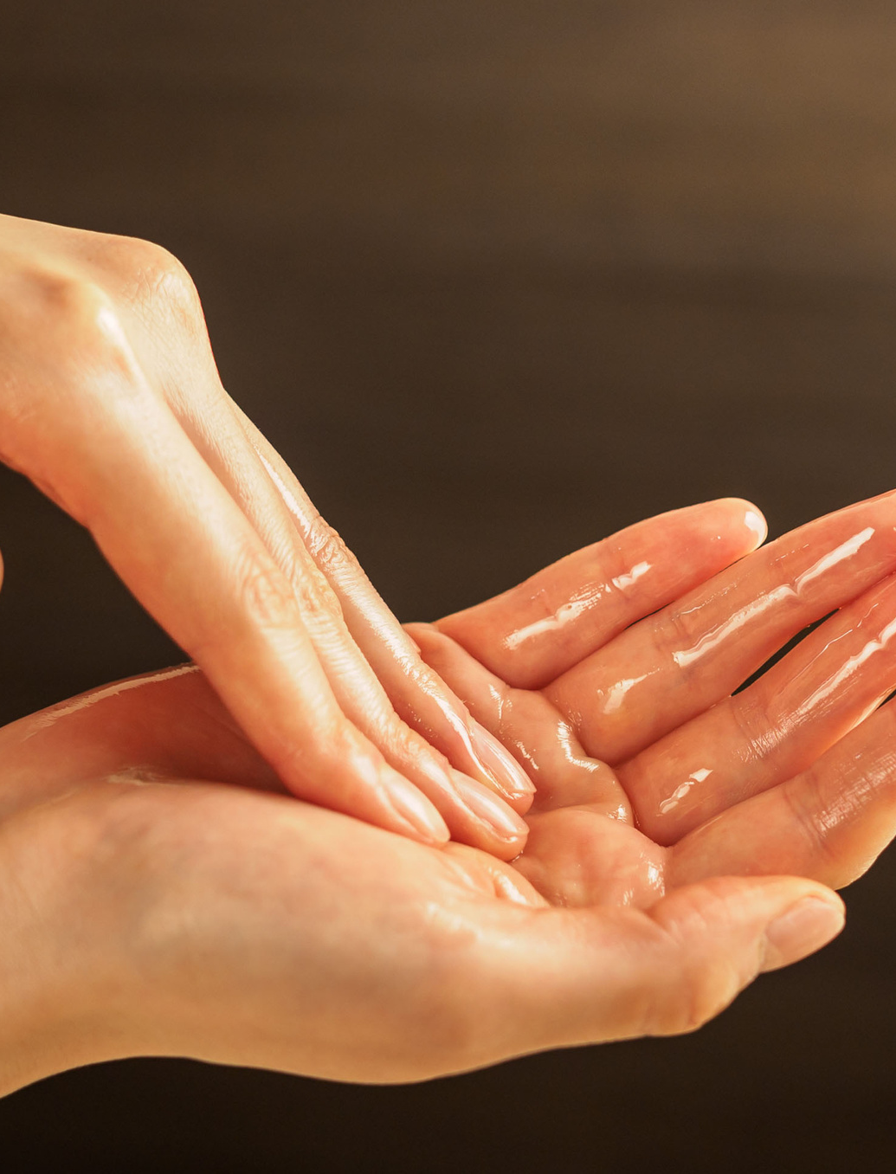
DO ABHYANGA BEFORE BATHING & BEFORE FOOD
20 minutes is enough to leave the oil on the skin. 7.5 minutes is the minimum.
Most important areas are ears, nostrils and head.
Don’t leave the oil on for more than one hour.

Slide 32
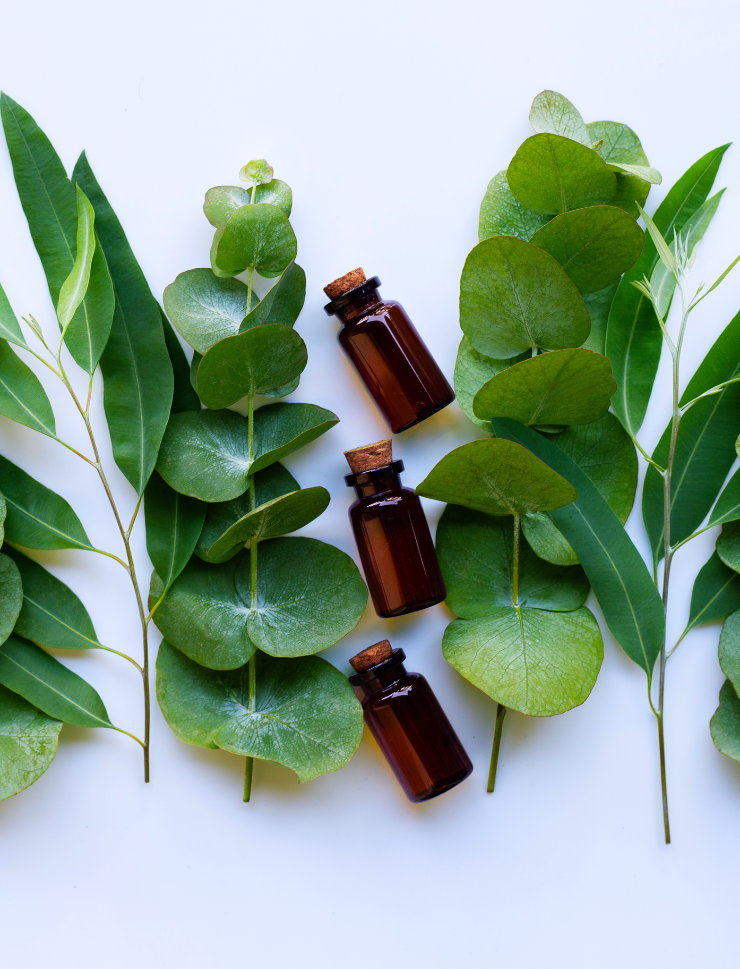
THE HEAD IS “UTTAMANGA” THE MOST IMPORTANT ORGAN
Don’t miss oiling the scalp when you do Abhyanga
Use approx. ¼ cup oil for the whole abhyanga (according to your body size).
Showering after abhyanga is better (to wash the toxins off).

Slide 33
DO CLOCKWISE circles on the joints and round places (e.g. head, shoulders, chest/breasts, stomach, low back);
LONG strokes on the limbs and long places (e.g. arms, legs, neck, spine).
DOWNWARD STROKES ARE BEST FOR VATA because vata has to go down to get pacified & clear the excess dosha/too much vata.
STROKES & CIRCLES "in the direction of the hair" are good and will be more soothing.
GENTLE PRESSING on the head is good, but nothing hard or heavy.
FOR PROBLEM AREAS in the body, you can spend some extra time with more strokes there (gently).
STROKES SHOULD NOT BE HARD OR FAST IN DAILY ABHYANGA.

Slide 34
SELF-MASSAGE - ABHYANGA
AVOID doing abhyanga:
During menstruation
If you have a cold or congestion
During a fever
If there is an over amount of kapha ama
Just after eating

Slide 35
HOW TO OPTIMISE YOUR DAILY ROUTINE
- FOLLOWING AN AYURVEDA CLOCK
01
02
THE TOP 5 SELF-CARE MORNING PRACTICES
HOW TO DO A SIMPLE SELF MASSAGE - ABHYANGA
03
NATURAL REMEDIES FOR COMMON IMBALANCES
04

Slide 36
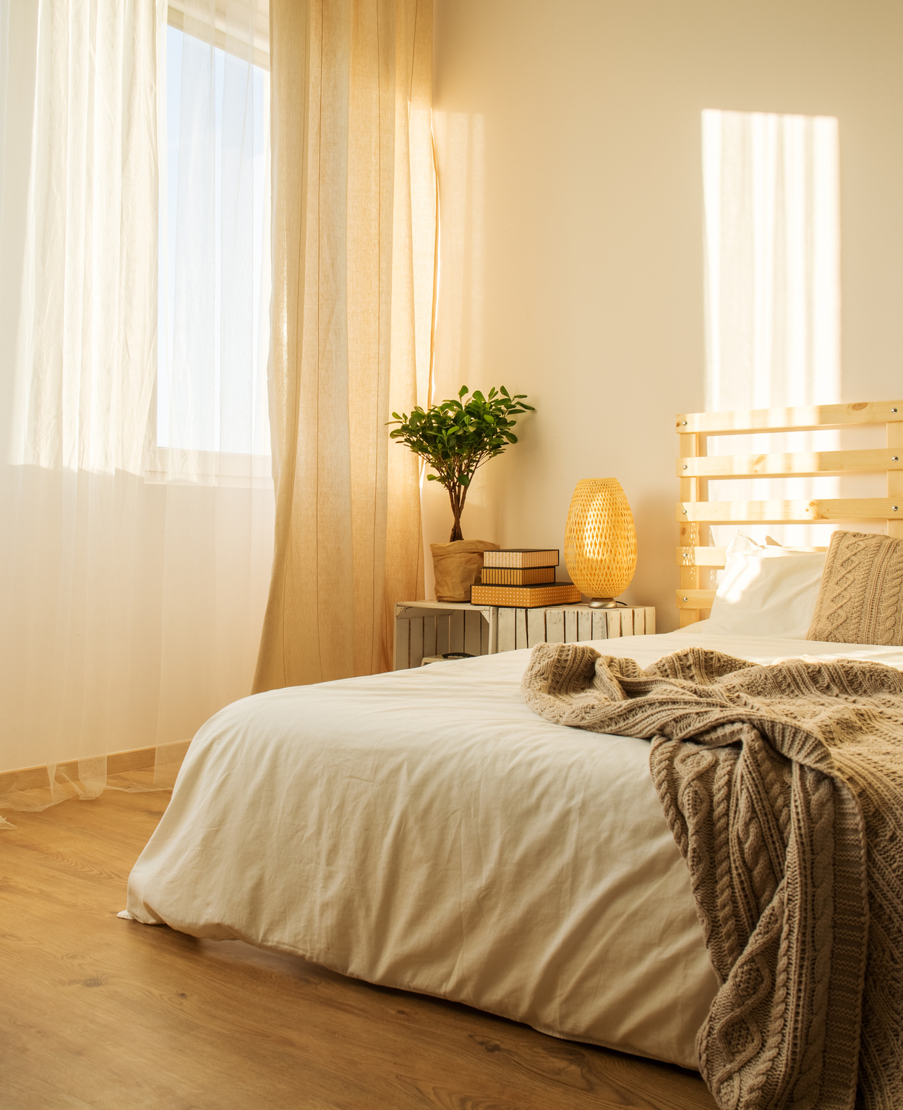
Insomnia
Vata pacifying diet.
Massage head and feet before sleep.
Hot milk with ghee at night.
Nasya.
Pranayama. Deep Breathing.
HERBS
Brahmi
Jatamansi
Ashwagandha
Tea:
Licorice, Cardamom, Cinnamon, Ginger; add rose and mint if pita

Slide 37
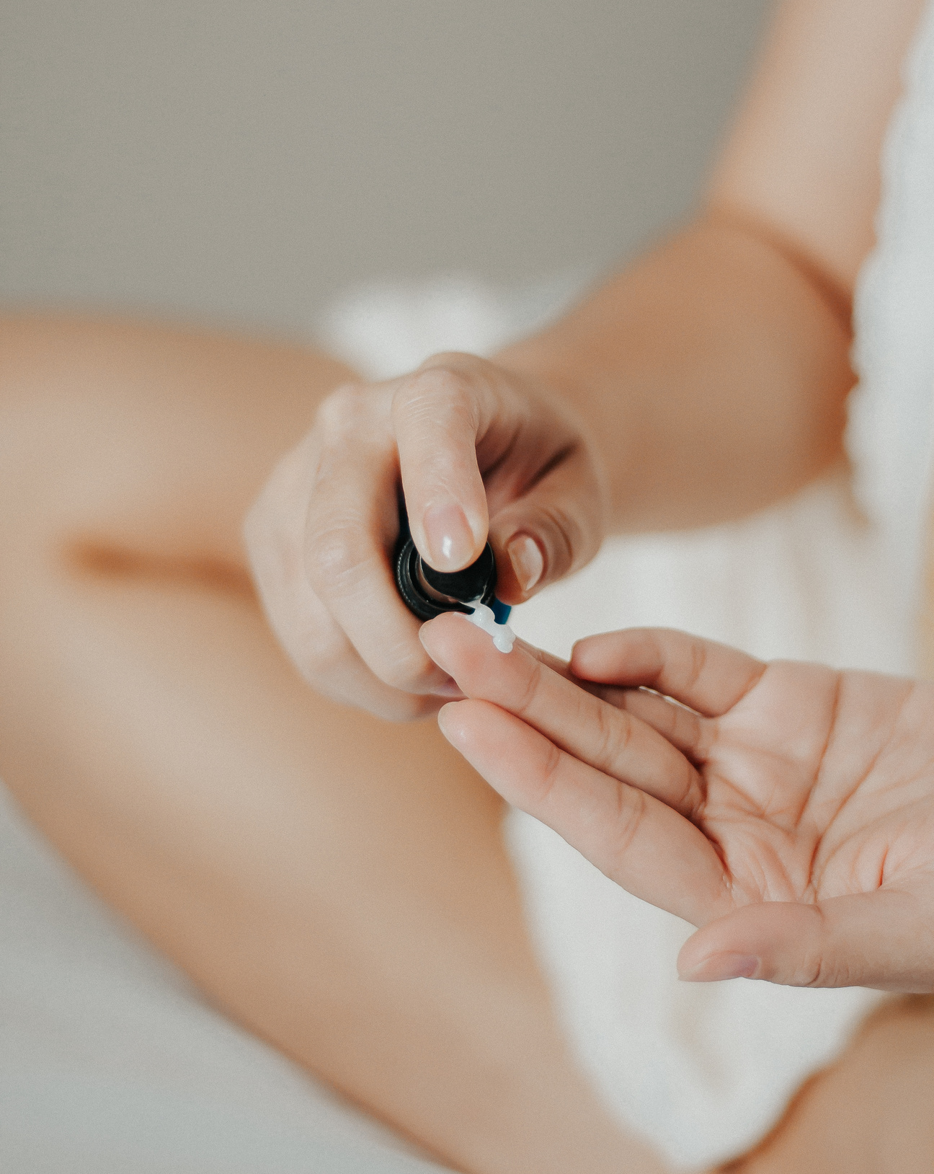
Skin Disorders (rashes, pimples, acne)
Food that aggravates pitta should be eliminated from the diet. Hot, spicy, acidic, sour, fried, oily and greasy foods. Minimize white sugar and flour.
INCLUDE:
Manjishta - blood purifier
Turmeric
Rose - good for pitta imbalances
Coriander water - to redirect the toxins away from the skin and into the urine

Slide 38
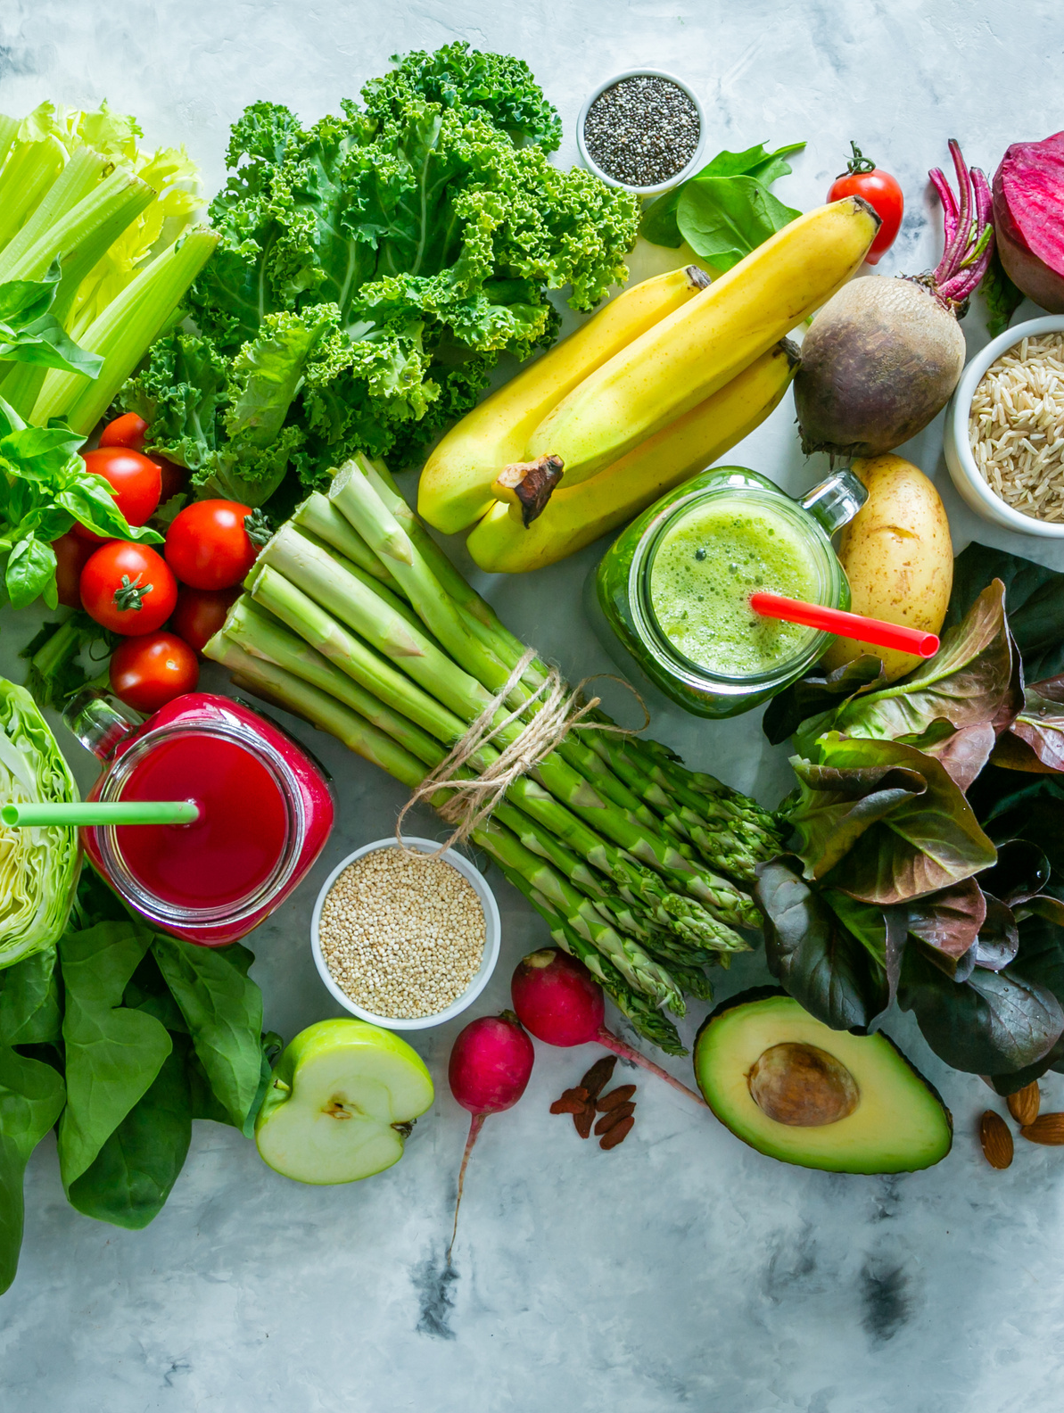
Constipation
IINCLUDE IN YOUR DIET:
Stewed apple
Hot milk with ghee at night
Rose petal jam
Soaked raisins and prunes
Probiotics - lassi or takra
Papaya
Steamed greens drizzled with olive oil
or ghee
Fennel tea
Tamarind prune chutney
Kichari

Slide 39
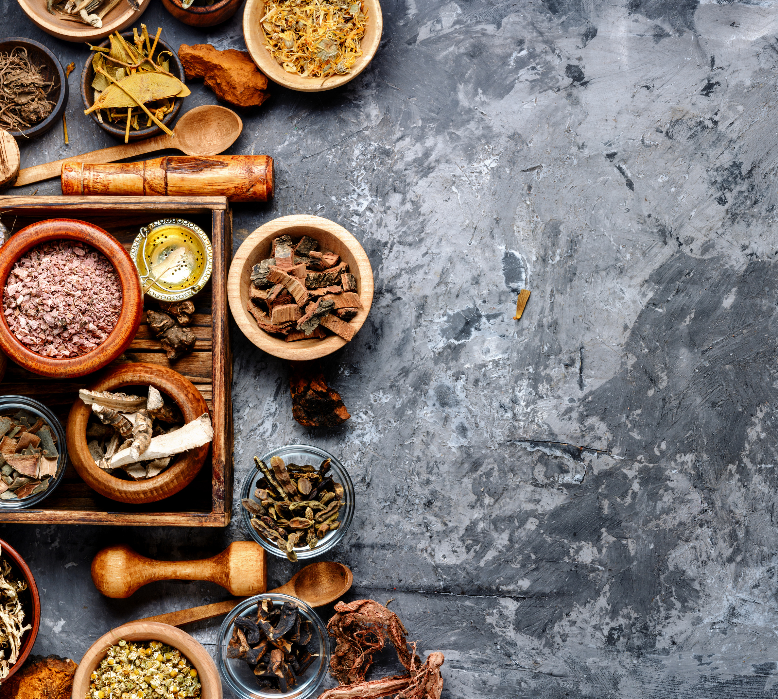
Constipation
HERBS:
Triphala with warm water before dinner
Psyllium husk
Slippery Elm
Avipattika Churna
Ginger

Slide 40

Lifestyle Recommendations
Drink warm water throughout the day
Avoid late or heavy meals at night
Apply 3-4 drops of warm castor oil on the navel at night
Yoga for constipation - Pavanmuktasana; malasana; Sun Salutations
Be active.
Try to be regulated in your lifestyle.
AFFIRIMATIONS:
"I am releasing everything stagnant from my life, body, and spirit."
"I invite clarity, purity and freedom into my life."

Slide 41



THANK YOU
www.thevediclife.com
facebook/thevediclife
sisterhealingco

